Slide 1


Data Mining and Data Warehousing
CSE-4107
Md. Manowarul Islam
Associate Professor, Dept. of CSE
Jagannath University

Slide 2
Sequence Databases
A sequence database consists of ordered elements or events
Transaction databases vs. sequence databases
A transaction database
A sequence database
TID | itemsets
10 | a, b, d
20 | a, c, d
30 | a, d, e
40 | b, e, f
SID | sequences
10 | <a(abc)(ac)d(cf)>
20 | <(ad)c(bc)(ae)>
30 | <(ef)(ab)(df)cb>
40 | <eg(af)cbc>

Slide 3
Examples of Sequence Data
Sequence Database | Sequence | Element/Events (Transaction) | Item
Customer | Purchase history of a given customer | A set of items bought by a customer at time t | Books, diary products, CDs, etc
Web Data | Browsing activity of a particular Web visitor | A collection of files viewed by a Web visitor after a single mouse click | Home page, index page, contact info, etc
Event data | History of events generated by a given sensor | Events triggered by a sensor at time t | Types of alarms generated by sensors
Genome sequences | DNA sequence of a particular species | An element of the DNA sequence | Bases A,T,G,C
Element (Transaction)
Item
E1
E2
E1
E3
E2
E2
E3
E4
Sequence

Slide 4
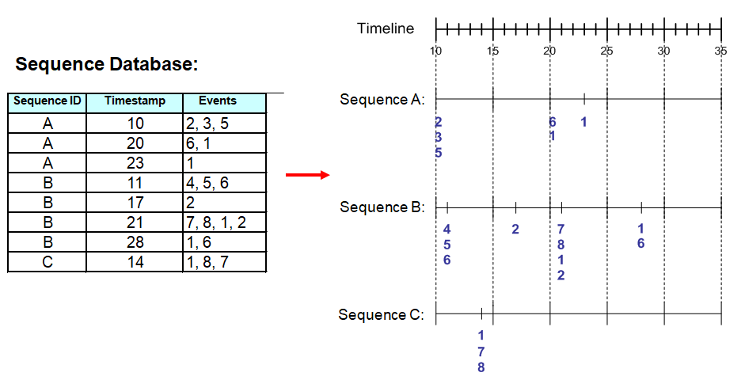
Sequence Data

Slide 5
Sequence Data vs. Market-basket Data
Sequence Database:
Market- basket Data
Customer
Date
Items bought
Events
2, 3, 5
1,6
1
4,5,6
2
1,2,7,8
1,6
1,7,8
A
10
2, 3, 5
A
20
1,6
A
23
1
B
11
4, 5, 6
B
17
2
B
21
1,2,7,8
B
28
1, 6
C
14
1,7,8

Slide 6
Sequence Data vs. Market-basket Data
Sequence Database:
Market- basket Data
Customer
Date
Items bought
Events
2, 3, 5
1,6
1
4,5,6
2
1,2,7,8
1,6
1,7,8
A
10
2, 3, 5
A
20
1,6
A
23
1
B
11
4, 5, 6
B
17
2
B
21
1,2,7,8
B
28
1, 6
C
14
1,7,8

Slide 7


Sequence Data vs. Market-basket Data
Sequence Database:
Market- basket Data
Customer
Date
Items bought
Events
2, 3, 5
1,6
1
4,5,6
2
1,2,7,8
1,6
1,7,8
A
10
2, 3, 5
A
20
1,6
A
23
1
B
11
4, 5, 6
B
17
2
B
21
1,2,7,8
B
28
1, 6
C
14
1,7,8
{2} -> {1}
(1,8) -> (7)

Slide 8
Formal Definition of a Sequence
A sequence is an ordered list of events (transactions)
  s = < e₁ e₂ e₃ … >
  Each event contains a collection of items
  e_{i} = {i₁, i₂, …, i_{k}}
  Each element is attributed to a specific time or location
Length of a sequence, |s|, is given by the number of items/instances of the sequence
A k-sequence is a sequence that contains k items/instances

Slide 9
Examples of Sequence
Web sequence:
  < {Homepage} {Electronics} {Digital Cameras} {Canon Digital Camera} {Shopping Cart} {Order Confirmation} {Return to Shopping} >
Sequence of books checked out at a library:
  <{Fellowship of the Ring} {The Two Towers} {Return of the King}>

Slide 10
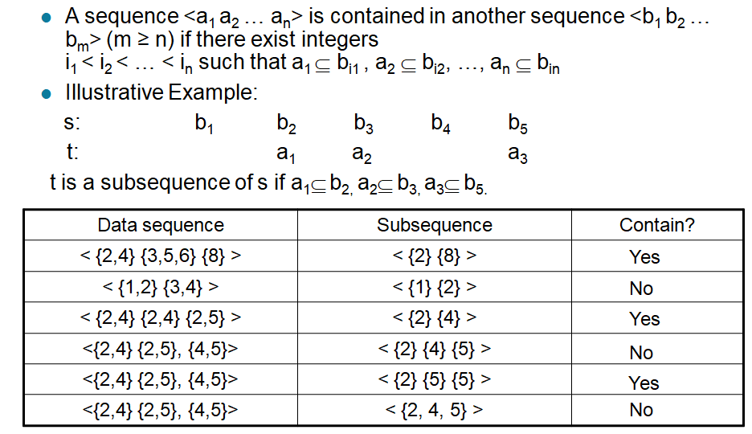
Formal Definition of a Subsequence

Slide 11
Formal Definition of a Subsequence
A sequence <a₁ a₂ … a_{n}> is contained in another sequence <b₁ b₂ … b_{m}> (m ≥ n) if there exist integers
i₁ < i₂ < … < i_{n} such that a₁ ⊆ b_{i1} , a₂ ⊆ b_{i1}, …, a_{n} ⊆ b_{in}
The support of a subsequence w is defined as the fraction of data sequences that contain w
A sequential pattern is a frequent subsequence (i.e., a subsequence whose support is ≥ minsup)
Data sequence | Subsequence | Contain?
< {2,4} {3,5,6} {8} > | < {2} {3,5} > | Yes
< {1,2} {3,4} > | < {1} {2} > | No
< {2,4} {2,4} {2,5} > | < {2} {4} > | Yes

Slide 12
Applications
Applications of sequential pattern mining
  Customer shopping sequences:
    First buy computer, then CD-ROM, and then digital camera, within 3 months.
  Medical treatments, natural disasters (e.g., earthquakes), science & eng. processes, stocks and markets, etc.
  Telephone calling patterns, Weblog click streams
  DNA sequences and gene structures

Slide 13
Sequential Pattern Mining: Definition
Given:
  a database of sequences
  a user-specified minimum support threshold, minsup
Task:
  Find all subsequences with support ≥ minsup

Slide 14
What Is Sequential Pattern Mining?
Given a set of sequences and support threshold, find the complete set of frequent subsequences
A sequence : < (ef) (ab) (df) c b >
A sequence database
SID | sequence
10 | <a(abc)(ac)d(cf)>
20 | <(ad)c(bc)(ae)>
30 | <(ef)(ab)(df)cb>
40 | <eg(af)cbc>
An element may contain a set of items.
Items within an element are unordered
and we list them alphabetically.
<a(bc)dc> is a subsequence of <a(abc)(ac)d(cf)>
Given support threshold min_sup =2, <(ab)c> is a sequential pattern

Slide 15
Challenges on Sequential Pattern Mining
A huge number of possible sequential patterns are hidden in databases
A mining algorithm should
  find the complete set of patterns, when possible, satisfying the minimum support (frequency) threshold
  be highly efficient, scalable, involving only a small number of database scans
  be able to incorporate various kinds of user-specific constraints

Slide 16
Studies on Sequential Pattern Mining
Concept introduction and an initial Apriori-like algorithm
  Agrawal & Srikant. Mining sequential patterns, [ICDE’95]
Apriori-based method: GSP (Generalized Sequential Patterns: Srikant & Agrawal [EDBT’96])
Pattern-growth methods: FreeSpan & PrefixSpan (Han et al.KDD’00; Pei, et al. [ICDE’01])
Vertical format-based mining: SPADE (Zaki [Machine Leanining’00])
Constraint-based sequential pattern mining (SPIRIT: Garofalakis, Rastogi, Shim [VLDB’99]; Pei, Han, Wang [CIKM’02])
Mining closed sequential patterns: CloSpan (Yan, Han & Afshar [SDM’03])

Slide 17
Methods for sequential pattern mining
Apriori-based Approaches
  GSP
  SPADE
Pattern-Growth-based Approaches
  FreeSpan
  PrefixSpan

Slide 18
GSP—Generalized Sequential Pattern Mining
GSP (Generalized Sequential Pattern) mining algorithm
Outline of the method
  Initially, every item in DB is a candidate of length-1
  for each level (i.e., sequences of length-k) do
    scan database to collect support count for each candidate sequence
    generate candidate length-(k+1) sequences from length-k frequent sequences using Apriori
  repeat until no frequent sequence or no candidate can be found
Major strength: Candidate pruning by Apriori

Slide 19
GSP—Generalized Sequential Pattern Mining
Step 1:
  Make the first pass over the sequence database D to yield all the 1-element frequent sequences
Step 2:
Repeat until no new frequent sequences are found
  Candidate Generation:
    Merge pairs of frequent subsequences found in the (k-1)th pass to generate candidate sequences that contain k items
  Candidate Pruning:
    Prune candidate k-sequences that contain infrequent (k-1)-subsequences
  Support Counting:
    Make a new pass over the sequence database D to find the support for these candidate sequences
  Candidate Elimination:
    Eliminate candidate k-sequences whose actual support is less than minsup

Slide 20
Candidate Generation
Base case (k=2):
  Merging two frequent 1-sequences <{i₁}> and <{i₂}> will produce two candidate 2-sequences: <{i₁} {i₂}> and <{i₁ i₂}>
General case (k>2):
  A frequent (k-1)-sequence w₁ is merged with another frequent
  (k-1)-sequence w₂ to produce a candidate k-sequence if the subsequence obtained by removing the first item in w₁ is the same as the subsequence obtained by removing the last item in w₂
    The resulting candidate after merging is given by the sequence w₁ extended with the last event of w₂.
      If the last element of w2 has only one event, append it to w1
      Otherwise add the event from the last element of w2 (which is absent in the last element of w1) to the last element of w1

Slide 21
Candidate Generation Examples
Merging the sequences
w₁=<{1} {2 3} {4}> and w₂ =<{2 3} {4 5}>
w₁=<{1} {2 3} {4}> and w₂ =<{2 3} {4 5}>
  {2,3}{4} and {2,3}{4} are same
  So, will produce the candidate sequence
  < {1} {2 3} {4 5}>
{4 5}> because the last two items in w₂ (4 and 5) belong to the same element/event
The resulting candidate after merging is given by the sequence w₁ extended with the last event of w₂.
        add the event from the last element of w2 (which is absent in the last element of w1) to the last element of w1

Slide 22
Candidate Generation Examples
Merging the sequences
w₁=<{1} {2 3} {4}> and w₂ =<{2 3} {4 }{5}>
w₁=<{1} {2 3} {4}> and w₂ =<{2 3} {4 }{5}>
  {2,3}{4} and {2,3}{4} are same
  So, will produce the candidate sequence
  < {1} {2 3} {4}{5}>
{4}{5} because the last two items in w₂ (4 and 5) do not belong to the same element
The resulting candidate after merging is given by the sequence w₁ extended with the last event of w₂.
        If the last element of w2 has only one event, append it to w1

Slide 23
Candidate Generation Examples
We do not have to merge the sequences
w₁ =<{1} {2 6} {4}> and w₂ =<{1} {2} {4 5}>
to produce the candidate < {1} {2 6} {4 5}> because if the latter is a viable candidate, then it can be obtained by merging w₁ with
< {1} {2 6} {4 5}>
        Otherwise add the event from the last element of w2 (which is absent in the last element of w1) to the last element of w1

Slide 24
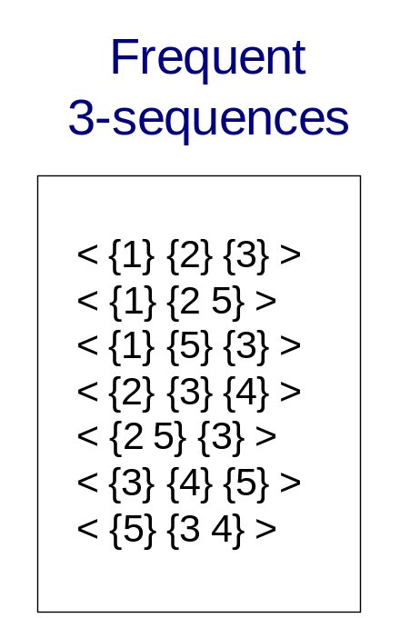
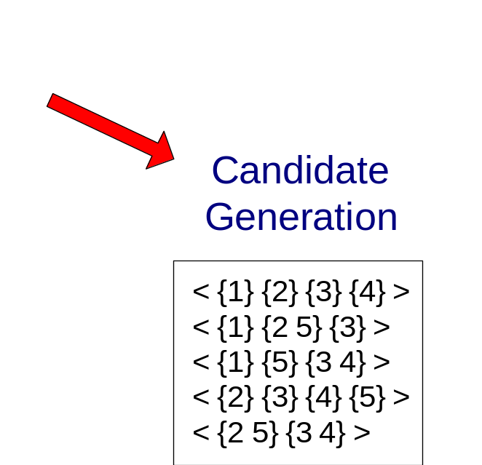
GSP Example

Slide 25
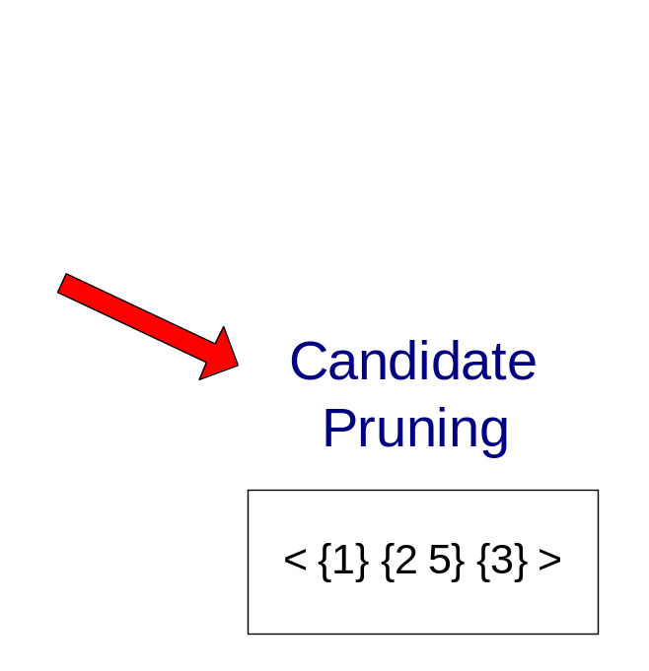
GSP Example

Slide 26
GSP Example
Suppose now we have 3 items: 1, 2, 3, and let min-support be 50%.
The sequence database is shown in following table:
Object | Sequence
A | (1), (2), (3)
B | (1, 2), (3)
C | (1), (2, 3)
D | (1, 2, 3)
E | (1, 2), (2, 3), (1, 3)

Slide 27
GSP Example
Step 1: Make the first pass over the sequence database D to yield all the 1-element frequent sequences
Candidate 1-sequences are: <{1}>, <{2}>, <{3}>
Object | Sequence
A | (1), (2), (3)
B | (1, 2), (3)
C | (1), (2, 3)
D | (1, 2, 3)
E | (1, 2), (2, 3), (1, 3)
Candidate | Support
{1} | 5
{2} | 5
{3} | 5

Slide 28
GSP Example
Object | Sequence
A | (1), (2), (3)
B | (1, 2), (3)
C | (1), (2, 3)
D | (1, 2, 3)
E | (1, 2), (2, 3), (1, 3)
Step 2a: Candidate Generation: Merge pairs of frequent subsequences found in the (k-1)th pass to generate candidate sequences that contain k items
Candidate 1-sequences are: <{1}>, <{2}>, <{3}>
Base case (k=2): Merging two frequent 1-sequences <{i₁}> and <{i₂}> will produce two candidate 2-sequences: <{i₁} {i₂}> and <{i₁ i₂}>
 | {1} | {2} | {3}
{1} | {1}{1} | {1}{2} | {1}{3}
{2} | {2}{1} | {2}{2} | {2}{3}
{3} | {3}{1} | {3}{2} | {3}{3}
 | {1} | {2} | {3}
{1} |  | {1 2} | {1 3}
{2} |  |  | {2 3}
{3}

Slide 29
GSP Example
Object | Sequence
A | (1), (2), (3)
B | (1, 2), (3)
C | (1), (2, 3)
D | (1, 2, 3)
E | (1, 2), (2, 3), (1, 3)
Candidate 2-sequences are:
<{1, 2}>, <{1, 3}>, <{2, 3}>,
<{1}, {1}>, <{1}, {2}>, <{1}, {3}>,
<{2}, {1}>, <{2}, {2}>, <{2}, {3}>,
<{3}, {1}>, <{3}, {2}>, <{3}, {3}>
 | {1} | {2} | {3}
{1} | {1}{1} | {1}{2} | {1}{3}
{2} | {2}{1} | {2}{2} | {2}{3}
{3} | {3}{1} | {3}{2} | {3}{3}
 | {1} | {2} | {3}
{1} |  | {1 2} | {1 3}
{2} |  |  | {2 3}
{3}

Slide 30
GSP Example
Object | Sequence
A | (1), (2), (3)
B | (1, 2), (3)
C | (1), (2, 3)
D | (1, 2, 3)
E | (1, 2), (2, 3), (1, 3)
Step 2b: Candidate Pruning: Prune candidate k-sequences that contain infrequent (k-1)-subsequences
Candidate 2-sequences are:
<{1, 2}>, <{1, 3}>, <{2, 3}>,
<{1}, {1}>, <{1}, {2}>, <{1}, {3}>,
<{2}, {1}>, <{2}, {2}>, <{2}, {3}>,
<{3}, {1}>, <{3}, {2}>, <{3}, {3}>
After candidate pruning, the 2-sequences should remain the same:
<{1, 2}>, <{1, 3}>, <{2, 3}>,
<{1}, {1}>, <{1}, {2}>, <{1}, {3}>,
<{2}, {1}>, <{2}, {2}>, <{2}, {3}>,
<{3}, {1}>, <{3}, {2}>, <{3}, {3}>

Slide 31
GSP Example
Object | Sequence
A | (1), (2), (3)
B | (1, 2), (3)
C | (1), (2, 3)
D | (1, 2, 3)
E | (1, 2), (2, 3), (1, 3)
Candidate | Support
<{1, 2}> | 3
<{1, 3}> | 2
<{2, 3}> | 3
<{1}, {1}> | 1
<{1}, {2}> | 3
<{1}, {3}>, | 4
<{2}, {1}>, | 1
<{2}, {2}>, | 1
<{2}, {3}>, | 3
<{3}, {1}> | 1
<{3}, {2}>, | 0
<{3}, {3}> | 1
Step 2c and 2d: Support Counting and Candidate Elimination:
After candidate elimination, the remaining frequent 2-sequences are:
<{1, 2}> (support=0.6) ,
<{2, 3}> (support=0.6),
<{1}, {2}> (support=0.6),
<{1}, {3}> (support=0.8),
<{2}, {3}> (support=0.6)`

Slide 32
GSP Example
Object | Sequence
A | (1), (2), (3)
B | (1, 2), (3)
C | (1), (2, 3)
D | (1, 2, 3)
E | (1, 2), (2, 3), (1, 3)
Repeat Step 2a: Candidate Generation
Generate 3-sequences from the remaining 2-sequences : <{1, 2}> , <{2, 3}>, <{1}, {2}>, <{1}, {3}> , <{2}, {3}>
3-sequences are:
<{1, 2, 3}> (generated from <{1, 2}> and <{2, 3}>),
<{1, 2}, {3}> (generated from <{1, 2}> and <{2}, {3}>),
<{1}, {2}, {3}> (generated from <{1}, {2}> and <{2}, {3}>)

Slide 33
GSP Example
Object | Sequence
A | (1), (2), (3)
B | (1, 2), (3)
C | (1), (2, 3)
D | (1, 2, 3)
E | (1, 2), (2, 3), (1, 3)
Repeat Step 2b: Candidate Pruning
2-sequences : <{1, 2}> , <{2, 3}>, <{1}, {2}>, <{1}, {3}> , <{2}, {3}>
3-sequences are: <{1, 2, 3}> <{1, 2}, {3}> <{1}, {2}, {3}>
<{1, 2, 3}> should be pruned because one 2-subsequences <{1, 3}> is not frequent.
<{1, 2}, {3}> should not be pruned because all 2-subsequences <{1}, {3}> and <{2}, {3}> are frequent.
<{1}, {2}, {3}> should not be pruned because all 2-subsequences <{1}, {2}>, <{2}, {3}> and <{1}, {3}> are frequent.

Slide 34
GSP Example
Object | Sequence
A | (1), (2), (3)
B | (1, 2), (3)
C | (1), (2, 3)
D | (1, 2, 3)
E | (1, 2), (2, 3), (1, 3)
Repeat Step 2b: Candidate Pruning
2-sequences : <{1, 2}> , <{2, 3}>, <{1}, {2}>, <{1}, {3}> , <{2}, {3}>
3-sequences are: <{1, 2, 3}> <{1, 2}, {3}> <{1}, {2}, {3}>
So after pruning, the remaining 3-sequences are:
<{1, 2}, {3}> and <{1}, {2}, {3}>

Slide 35
GSP Example
Object | Sequence
A | (1), (2), (3)
B | (1, 2), (3)
C | (1), (2, 3)
D | (1, 2, 3)
E | (1, 2), (2, 3), (1, 3)
Repeat Step 2c: Support Counting
3-sequences are: <{1, 2}, {3}> <{1}, {2}, {3}>
Candidate | Support
<{1, 2}, {3}> | 2
<{1}, {2}, {3}> | 2
Thus, there are no 3-sequences left.
So the final frequent sequences are:
<{1}>, <{2}>, <{3}>,
<{1, 2}>, <{2, 3}>, <{1}, {2}>, <{1}, {3}>, <{2}, {3}>

Slide 36
The Apriori Property of Sequential Patterns
A basic property: Apriori (Agrawal & Sirkant’94)
  If a sequence S is not frequent
  Then none of the super-sequences of S is frequent
  E.g, <hb> is infrequent → so do <hab> and <(ah)b>
Seq. ID
Sequence
Given support threshold min_sup =2
10
<(bd)cb(ac)>
20
<(bf)(ce)b(fg)>
30
<(ah)(bf)abf>
40
<(be)(ce)d>
50
<a(bd)bcb(ade)>

Slide 37
Finding Length-1 Sequential Patterns
Examine GSP using an example
Initial candidates: all singleton sequences
  <a>, <b>, <c>, <d>, <e>, <f>, <g>, <h>
Scan database once, count support for candidates
Cand | Sup
<a> | 3
<b> | 5
<c> | 4
<d> | 3
<e> | 3
<f> | 2
<g> | 1
<h> | 1
min_sup =2
Seq. ID
Sequence
10
<(bd)cb(ac)>
20
<(bf)(ce)b(fg)>
30
<(ah)(bf)abf>
40
<(be)(ce)d>
50
<a(bd)bcb(ade)>

Slide 38
GSP: Generating Length-2 Candidates
 | <a> | <b> | <c> | <d> | <e> | <f>
<a> | <aa> | <ab> | <ac> | <ad> | <ae> | <af>
<b> | <ba> | <bb> | <bc> | <bd> | <be> | <bf>
<c> | <ca> | <cb> | <cc> | <cd> | <ce> | <cf>
<d> | <da> | <db> | <dc> | <dd> | <de> | <df>
<e> | <ea> | <eb> | <ec> | <ed> | <ee> | <ef>
<f> | <fa> | <fb> | <fc> | <fd> | <fe> | <ff>
51 length-2
Candidates
 | <a> | <b> | <c> | <d> | <e> | <f>
<a> |  | <(ab)> | <(ac)> | <(ad)> | <(ae)> | <(af)>
<b> |  |  | <(bc)> | <(bd)> | <(be)> | <(bf)>
<c> |  |  |  | <(cd)> | <(ce)> | <(cf)>
<d> |  |  |  |  | <(de)> | <(df)>
<e> |  |  |  |  |  | <(ef)>
<f>
Without Apriori property,
8*8+8*7/2=92 candidates
Apriori prunes
44.57% candidates

Slide 39
The GSP Mining Process
5th scan: 1 cand. 1 length-5 seq. pat.
<(bd)cba>
Cand. cannot pass sup. threshold
4th scan: 8 cand. 6 length-4 seq. pat.
<abba> <(bd)bc> …
Cand. not in DB at all
3rd scan: 47 cand. 19 length-3 seq. pat. 20 cand. not in DB at all
<abb> <aab> <aba> <baa> <bab> …
2nd scan: 51 cand. 19 length-2 seq. pat. 10 cand. not in DB at all
<aa> <ab> … <af> <ba> <bb> … <ff> <(ab)> … <(ef)>
1st scan: 8 cand. 6 length-1 seq. pat.
<a> <b> <c> <d> <e> <f> <g> <h>
Seq. ID
Sequence
10
<(bd)cb(ac)>
min_sup =2
20
<(bf)(ce)b(fg)>
30
<(ah)(bf)abf>
40
<(be)(ce)d>
50
<a(bd)bcb(ade)>

Slide 40
Thank you
http://simpledatamining.blogspot.com/2015/03/generalized-sequential-pattern-gsp.html

